Slide 1
Import multiple files
Import multiple
files

Slide 2
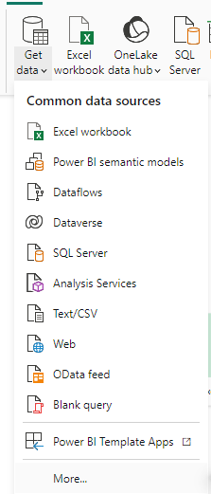
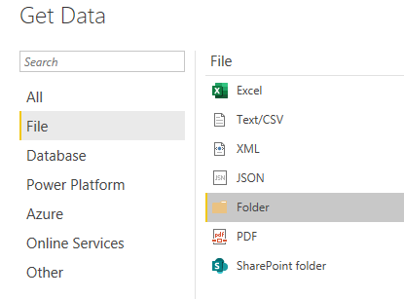
Importing from multiple files
Note: This Lab uses the csv files located at \resources\Multiple Files\Files
Choose data source from More… menu, then select File then Folder
2
3
1

Slide 3
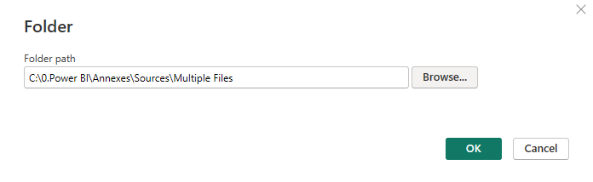
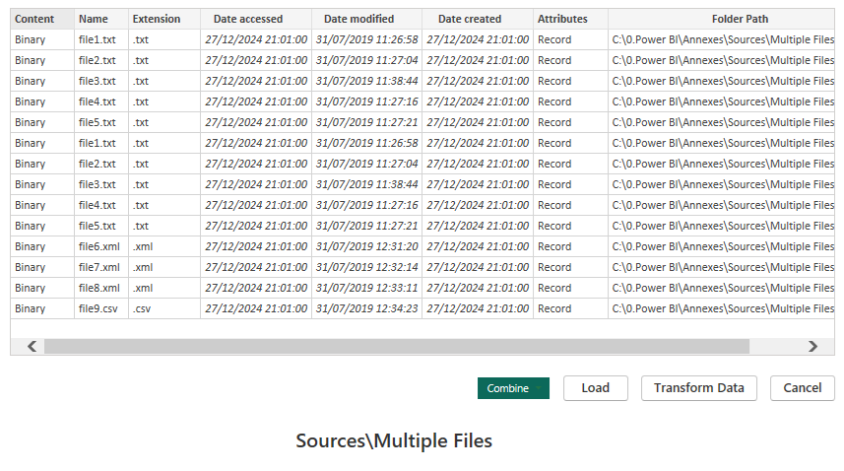

Importing from multiple files
Navigate to the Multiple Files folder located under Resources and select the
Check that the files represent the same structures, Choose Combine and Load

Slide 4
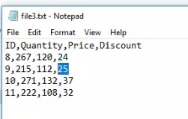
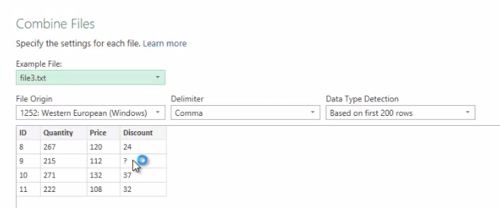
Importing from multiple files
Go back to the file3.txt in the disk and edit it replace the value 25 with empty or a special character to test the case where a file represents an anomaly when loading
Notice that when loading there is ? instead of the anomaly

Slide 5
Thank you
Thank you

